Slide 1
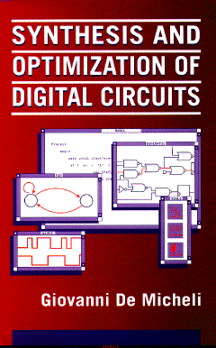


Libraries and Mapping
Giovanni De Micheli
Integrated Systems Centre
EPF Lausanne
This presentation can be used for non-commercial purposes as long as this note and the copyright footers are not removed
© Giovanni De Micheli – All rights reserved

Slide 2
Module 1
Objective
  Libraries. Problem formulation and analysis
  Algorithms for library binding based on structural methods

Slide 3
Library binding
Given an unbound logic network and a set of library cells
  Transform into an interconnection of instances of library cells
  Optimize delay
    (under area or power constraints)
  Optimize area
    Under delay and/or power constraints
  Optimize power
    Under delay and/or area constraints
Library binding is called also technology mapping
  Redesigning circuits in different technologies

Slide 4
Major approaches
Rule-based systems
  Generic, handle all types of cells and situations
  Hard to obtain circuit with specific properties
  Data base:
    Set of pattern pairs
    Local search: detect pattern, implement its best realization
Heuristic algorithms
  Typically restricted to single-output combinational cells
  Library described by cell functionality and parameters
Most systems use a combination of both approaches:
  Rules are used for I/Os, high buffering requirements, …

Slide 5
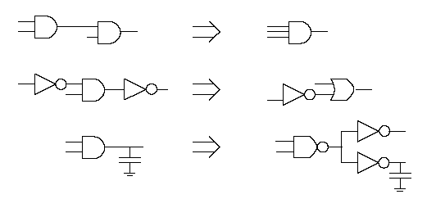
Example

Slide 6
Library binding: issues
Matching:
  A cell matches a sub-network when their terminal behavior is the same
  Tautology problem
  Input-variable assignment problem
Covering:
  A cover of an unbound network is a partition into sub-networks which can be replaced by library cells.
  Binate covering problem

Slide 7
Assumptions
Network granularity is fine
  Decomposition into base functions:
  2-input AND, OR, NAND, NOR
Trivial binding
  Use base cells to realize decomposed network
  There exists always a trivial binding:
    Base-cost solution…

Slide 8
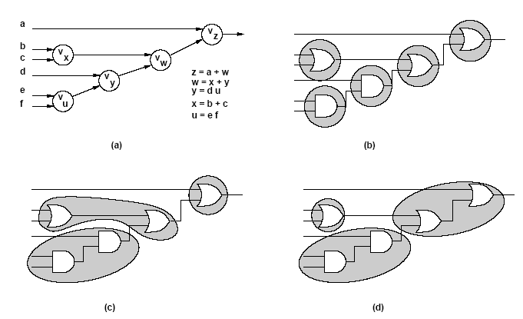
Example

Slide 9
Example
Library
Cost
a
v₂
y
AND2
4
x = b + c
y = ax
z = xd
b
OR2
4
v₁
x
c
OA21
5
v₃
d
z
m₁: {v₁,OR2}
a
y
m₂: {v₂,AND2}
v₂
b
x
m₃: {v₃,AND2}
v₁
x
c
m₄: {v₁,v₂,OA21}
z
v₃
d
m₅: {v₁,v₃,OA21}

Slide 10
Example
Vertex covering:
  Covering v₁ : ( m₁ + m₄ + m₅ )
  Covering v₂ : ( m₂ + m₄ )
  Covering v₃ : ( m₃ + m₅ )
Input compatibility:
  Match m₂ requires m₁
    (m’₂ + m₁)
  Match m₃ requires m₁
    (m’₃ + m₁ )
Overall binate covering clause
  (m₁+m₄+m₅) (m₂+m₄)(m₃+m₅)(m’₂+m₁)(m’₃+m₁) = 1
v₂
v₁
x
v₃

Slide 11
Heuristic approach to library binding
Split problem into various stages:
  Decomposition
    Cast network and library in standard form
    Decompose into base functions
    Example, NAND2 and INV
  Partitioning
    Break network into cones
    Reduce to many multi-input, single-output networks
  Covering
    Cover each sub-network by library cells
Most tools use this strategy
  Sometimes stages are merged

Slide 12
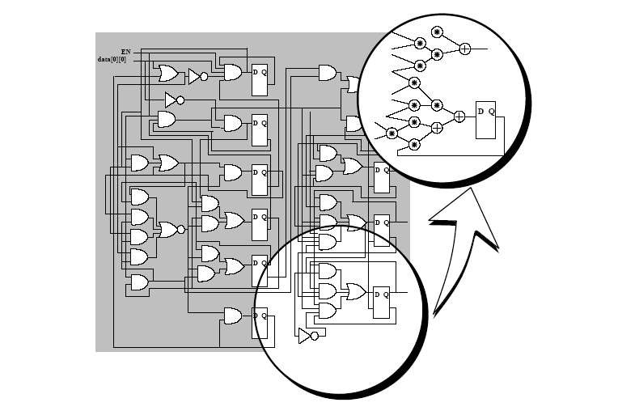
Decomposition

Slide 13
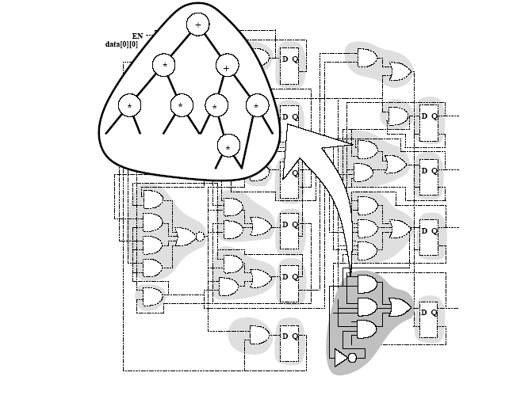
Partitioning

Slide 14
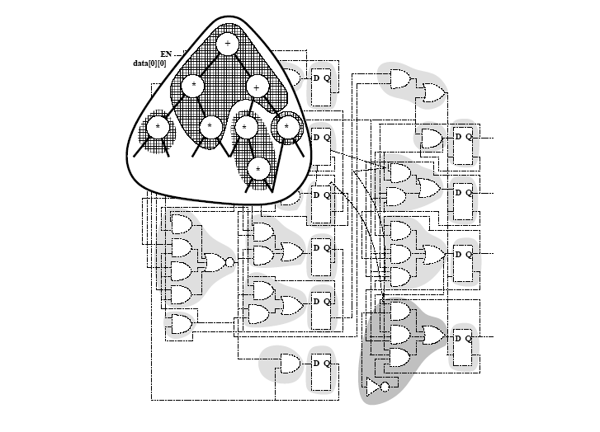
Covering

Slide 15
Heuristic algorithms
Structural approach
  Model functions by patterns
    Example: tree, dags
  Rely on pattern matching techniques
Boolean approach
  Use Boolean models
  Solve the tautology problem
    Use BDD technology
  More powerful

Slide 16
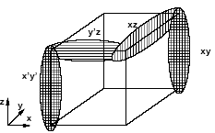
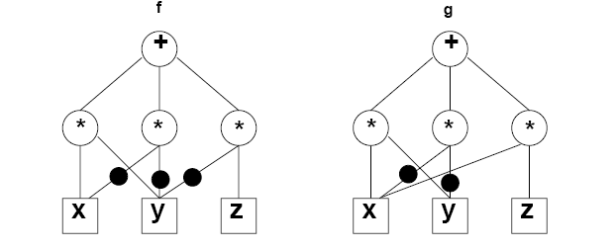
Example
Boolean vs. structural matching
f = xy + x’y’ + y’z
g = xy + x’y’ + xz
Function equality is a tautology
  Boolean match
Patterns may be different
  Structural match may not exist

Slide 17
Structural matching and covering
Expression patterns
  Represented by dags
Identify pattern dags in network
  Sub-graph isomorphism
Simplification:
  Use tree patterns
Typical problems with EXORs and MAJority functions

Slide 18
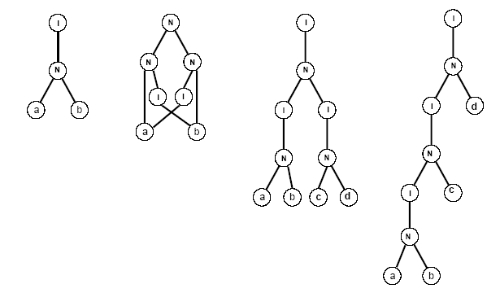
Example

Slide 19
Tree-based matching
Network:
  Partitioned and decomposed
    NOR2 (or NAND2) + INV
    Generic base functions
      Not much used
    Subject tree
Library
  Represented by trees
  Possibly more than one tree per cell
Pattern recognition
  Simple binary tree match
  Aho-Corasik automaton

Slide 20
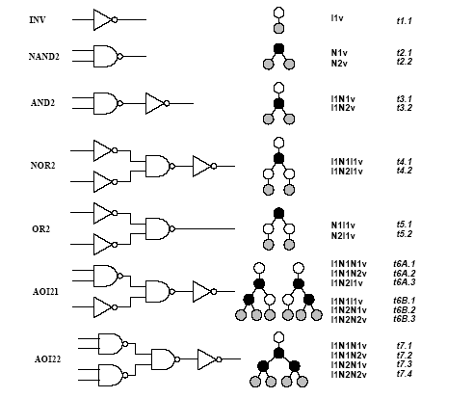
Simple library

Slide 21
Tree covering
Dynamic programming
  Visit subject tree bottom up
At each vertex
  Attempt to match:
    Locally rooted subtree to all library cell
    Find best match and record
  There is always a match when the base cells are in the library
Bottom-up search yields and optimum cover
Caveat:
  Mapping into trees is a distortion for some cells
  Overall optimality is weakened by the overall strategy of splitting into several stages

Slide 22
Example
SUBJECT TREE
PATTERN TREES
cost = 2
INV
cost = 3
NAND
cost = 4
AND
cost = 5
OR

Slide 23
Example: Lib
Match of s: t1
cost = 2
Match of t: t1
cost = 2+3 = 5
Match of t: t3
cost = 4
Match of r: t2
cost = 3+2+4 =9
Match of r: t4
cost = 5+3 =8
Match of u: t2
cost = 3
r
r
r
r
r
s
t
s
t
s
t
s
t
s
t
u
u
u
u
u

Slide 24
Different covering problems
Covering for minimum area:
  Each cell has a fixed area cost (label)
  Area is additive:
    Add area of match to cost of sub-trees
Covering for minimum delay:
  Delay is fanout independent
    Delay computed with (max, +) rules
    Add delay of match to highest cost of sub-trees
  Delay is fanout dependent
    Look-ahead scheme is required

Slide 25
Simple library

Slide 26
Example – minimum area cover
Area cost: INV:2 NAND2:3 AND2: 4 AOI21: 6
Network
Subject graph
Vertex
Match
Gate
Cost
o
x
t2
NAND2(b,c)
3
I
y
t1
INV(a)
2
w
z
t2
NAND2(x,d)
3+3 = 6
N
w
t2
NAND2(y,z)
3+6+ 2 = 11
y
z
o
t1
INV(w)
2+11 = 13
I
N
t3
AND2(y,z)
6 + 4 + 2 = 12
a
x
d
v
N
v
t6B
AOI21(x,d,a)
6 + 3 = 9
b
c
v
v

Slide 27
Example – minimum delay cover
Fixed delays: INV:2 NAND2:4 AND2: 5 AOI21: 10
All inputs are stable at time 0, except for t_{d} = 6
Network
Subject graph
Vertex
Match
Gate
Cost
o
x
t2
NAND2(b,c)
4
I
y
t1
INV(a)
2
w
z
t2
NAND2(x,d)
6+4 = 10
N
w
t2
NAND2(y,z)
10 + 4 = 14
y
z
o
t1
INV(w)
14 + 2 = 16
I
N
t3
AND2(y,z)
10 + 5 = 15
v
N
v
a
x
d
t6B
AOI21(x,d,a)
10 + 6 = 16
b
c
v
v

Slide 28
Minimum-delay cover for load-dependent delays
Model
  Gate delay is d = α + β cap_load
  Capacitive load depends on the driven cells (fanout cone)
  There is a finite (possibly small) set of capacitive loads
Algorithm
  Visit subject tree bottom up
  Compute an array of solutions for each possible load
  For each input to a matching cell, the best match for the corresponding load is selected
Optimality
  Optimum solution when all possible loads are considered
  Heuristic: group loads into bins

Slide 29
Example – minimum delay cover
Delays: INV:1+load NAND2: 3+load AND2: 4+load AOI21: 9+load
All inputs are stable at time 0, except for t_{d} = 6
All loads are 1
Same as before !
Network
Subject graph
Vertex
Match
Gate
Cost
o
x
t2
NAND2(b,c)
4
I
y
t1
INV(a)
2
w
z
t2
NAND2(x,d)
6+4 = 10
N
w
t2
NAND2(y,z)
10 + 4 = 14
y
z
o
t1
INV(w)
14 + 2 = 16
I
N
t3
AND2(y,z)
10 + 5 = 15
v
N
v
a
x
d
t6B
AOI21(x,d,a)
10 + 6 = 16
b
c
v
v

Slide 30
Example – minimum delay cover
Delays: INV: 1+load NAND2: 3+load AND2: 4+load AOI21: 9+load
All inputs are stable at time 0, except for t_{d} = 6
All loads are 1 (for cells seen so far)
Add new cell SINV with delay 1 + ½ load and load 2
The sub-network drives a load of 5

Slide 31
Example – minimum delay cover
Cost
Network
Subject graph
Vertex
Match
Gate
Load=1
Load=2
Load=5
o
x
t2
NAND2(b,c)
4
5
8
I
y
t1
INV(a)
2
3
6
w
z
t2
NAND2(x,d)
10
11
14
N
w
t2
NAND2(y,z)
14
15
18
y
z
o
t1
INV(w)
20
I
N
t3
AND2(y,z)
19
v
N
v
a
x
d
t6B
AOI21(x,d,a)
20
SINV(w)
18.5
b
c
v
v

Slide 32
Library binding and polarity assignment
Search for lower cost solutions allowing signals to be generated with inverted polarity
  More cells to choose from
Polarities can be adjusted at register and/or I/O boundaries
Within structural covering:
  Polarity assignment is handled by a smart trick
Within structural covering
  Polarity assignment is built into the formulation

Slide 33
Structural covering and polarity assignment
Assume subject network is decomposed into base functions such as NAND2 and INV
Pre-process subject network by adding inverter pairs between NANDs
Provide I/Os with both polarity
Add to library inverter-pair cell 2INV to the library:
  Cell corresponds to a connection and has 0 cost
  Unnecessary 2INV will be removed by the algorithm
Apply bottom-up dynamic programming cover algorithm

Slide 34
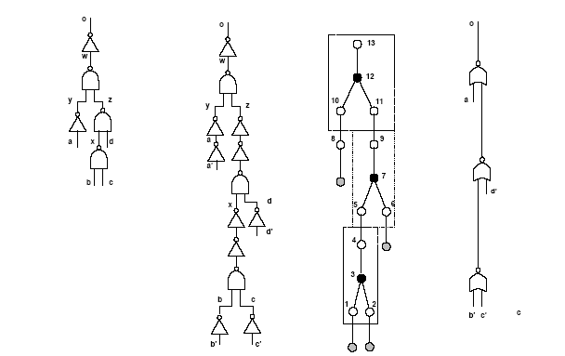
Example

Slide 35
General issues with covering
Decomposition and covering yield solutions that are locally sub-optimal at multiple fanout points
  Covering in various logic cones is independent
  High capacitive loads skews the solution
Approaches
  Implicit decomposition methods
    Compute and map all possible decompositions of a network
  Cell cloning and buffering at cone vertices
  Wavefront mapping

Slide 36
Wavefront mapping
A wavefront is a sub-network
  Cutting all I/O paths
  With width W
When W is the circuit depth, then covering for load-dependent delays is optimum
For reasonably smaller values of W, optimality is preserved
  The wavefront can be dynamically decomposed
  The wavefronit can be mapped (with duplications) for delay or other objectives

Slide 37
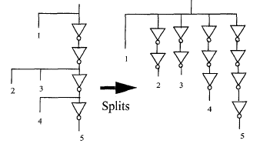
Buffering
Drive multiple sinks:
  Possibly with +/- polarities
  Possibly with different loads
  Possibly with different criticality
Logic/electrical effort theory
  delay = p + q gain
  gain = load/C_{in} is a design parameter
Issues:
  Determine minimal buffer tree delay
  Determine tree with minimal load
    satisfying all timing constraint
Solutions:
  Make electrical effort uniform in chains
    Closed form solution
  Adapt to non-continuous cell sizes and tree structure
    Gain based algorithm

Slide 38
Module 2
Objectives
  Boolean covering
  Boolean matching
  Simultaneous optimization and binding
  Extensions to Boolean methods

Slide 39
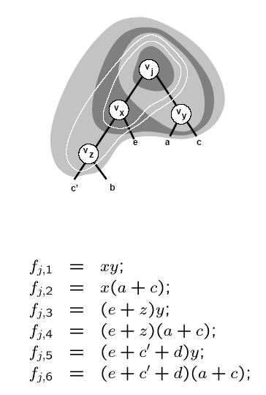
Boolean covering
Decompose network into base functions
Partition network into cones
Apply bottom-up covering to each cone
  When considering vertex v:
    Construct clusters by local elimination
    Limit the depth of the cluster by limiting the support of the function
    Associate several functions with vertex v
    Apply matching and record cost

Slide 40
Boolean matching
P-equivalence
Cluster function f(x)
  Sub-network behavior
Pattern function g(y)
  Cell behavior
P-equivalence
  Is there a permutation operator P, such that f(x) = g ( P x)
  is a tautology?
Approaches:
  Tautology check over all input permutations
  Multi-rooted pattern ROBDD capturing all permutations

Slide 41
Input/output polarity assignment
NPN classification of logic functions
NPN-equivalence
  There exist a permutation operator P and complementation operators N_{i} and N_{o}, such that f(x) = N_{o} g ( P N_{i} x) is a tautology
Variations:
  N-equivalence
  PN-equivalence

Slide 42
Boolean matching
Pin assignment problem:
  Map cluster variables x to pattern variables y
  Characteristic equation: A(x,y) = 1
Pattern function under variable assignment:
  g_{A} (x) = S_{y} ( A (x,y) g (y) )
Tautology problem
  f(x) = g_{A} (x)
  ∀_{x} f(x) = S_{y} ( A (x,y) g (y) )
x₁
&
f
x₂
y₁
g
y₂

Slide 43
Example
Cluster terminals: x -- cell terminals: y
Assign x₁ to y’₂ and x₂ to y₁
Characteristic equation
  A (x₁,x₂,y₁,y₂) = (x₁ ⊕ y₂) (x₂ ⊕ y₁)
AND pattern function
  g = y₁ y₂
Pattern function under assignment
  S_{y1y2} A g = S_{y1y2} ((x₁ ⊕ y₂) (x₁ ⊕ y₁) y₁ y₂ ) = x₂ x’₁
x₁
f
x₂
y₁
g
y₂

Slide 44
Signatures and filters
Capture some properties of Boolean functions
If signatures do not match, there is no match
Signatures are used as filters to reduce computation
Signatures:
  Unateness
  Symmetries
  Co-factor sizes
  Spectra

Slide 45
Filters based on unateness and symmetries
Any pin assignment must associate:
  Unate variables in f(x) with unate variables in g(y)
  Binate variables in f(x) with binate variables in g(y)
Variables or group of variables:
  That are interchangeable in f(x) must be interchangeable in g(y)

Slide 46
Example
Cluster function: f = abc
  Symmetries { { a,b,c} }
  Unate
Pattern functions
  g₁ = a + b + c
    Symmetries { { a,b,c} }
    Unate
  g₂ = ab +c
    Symmetries { {a,b}, {c} }
    Unate
  g₃ = abc’ + a’b’c
    Symmetries { {a,b,c} }
    Binate

Slide 47
Concurrent optimization and library binding
Motivation
  Logic simplification is usually done prior to binding
  Logic simplification and substitution can be combined with binding
Mechanism
  Binding induces some don’t care conditions
  Exploit don’t cares as degrees of freedom in matching

Slide 48
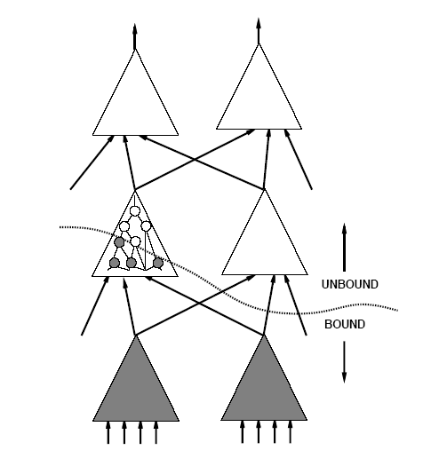
Example

Slide 49
Boolean matching with don’t care conditions
Given f(x), f_{DC}(x) and g(y)
  g matches f, if g is equivalent to h, where:
  f f’_{DC} ≤ h ≤ f + f_{DC}
Matching condition:
∀_{x} ( f_{DC}(x) + f(x) ⊕ S_{y} ( A (x,y) g(y) ) )

Slide 50
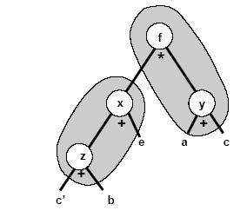
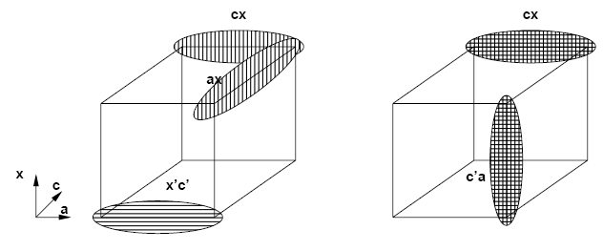
Example
Assume v_{x} is bound to an OR3(c’,b,e)
Don’t care set includes x ⊕ (c’+b+e)
Consider f_{j} = x(a+c) with CDC = x’c’
No simplification.
  Mapping into AOI gate.
Matching with DCs.
  Map to a MUX gate.

Slide 51
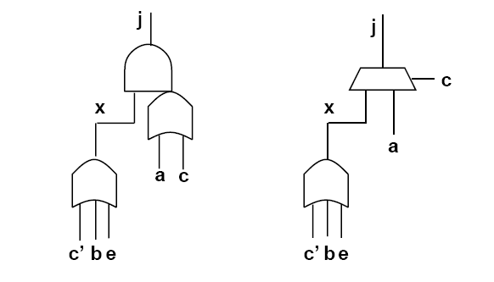
Example

Slide 52
Extended matching
Motivation:
  Search implicitly for best pin assignment
  Make a single test, determining matching and assignment
Technique:
  Construct BDD model of cell and assignments
Visual intuition:
  Imagine to place MUX function at cell inputs
  Each cell input can be routed to any cluster input (or voltage rail)
  Input polarity can be changed
  Cell and cluster may differ in size
Cell and multiplexers are described by a composite function G(x,c)
  Pin assignment is determining c
Matching formula M(c) = ∀_{x} [ G(x,c) ⊕ f(x) ]

Slide 53
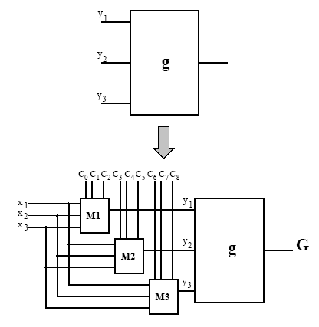
Example
g = y₁ + y₂ y’₃
y₁ (c,x) = (c₀c₁x₁ + c₀c’₁x₂ + c’₀c₁x₃) ⊕ c₂
G = y₁ (c,x) + y₂(c,x) y₃(c,x)’

Slide 54
Extended matching modeling
Model composite functions with ROBDDs
  Assume n-input cluster and m-input cell
  For each cell input:
    ┌ log₂ n ┐ variables for pin permutation
    One variable for input polarity
  Total size of c: m(┌ log₂ n┐ + 1 )
A match exists if there is at least one value of c satisfying M (c) = ∀_{x} [ G(x,c) ⊕ f(x) ]

Slide 55
Example
Cell: g=x’y
Cluster: f = wz’
G(a,b,c,d) = (c⊕(za+wa’))’(d⊕zb+wb’))
f⊕G=(wz’) ⊕ (c⊕(za+wa’))’(d⊕zb+wb’))
M(c) = ab’c’d’ + a’bcd
z
f
&
w
a
c
z
1
x
w
0
G
&
1
y
0
b
d

Slide 56
Extended matching
Extended matching captures implicitly all possible matches
No extra burden when exploiting don’t care sets
M (c) = ∀_{x} [ G(x,c) ⊕ f(x) + f_{DC}(x) ]
Efficient BDD representation
Extensions:
  Represent full library with one BDD structure
    Visualize as MUX at output of all library cells
    Composite function will indicated cell selection implicitly
  Support multiple-output matching

Slide 57
Summary
Library binding is a key step in synthesis
Most systems use some rules together with heuristic algorithms that concentrate on combinational logic
  Best results are obtained with Boolean matching
  Sometimes structural matching is used for speed
Library binding is tightly linked to buffering and to physical design

